Slide 1
Huffman Encoding Test Compression
By:
Kendall Zettlmeier
Piotr Gorski
Ledio Sinjari

Slide 2
Huffman Encoding
Huffman Encoding is a an algorithm used for lossless data compression.
Developed by David A. Huffman while he was a Ph.D. student at MIT.
The encoding breaks each symbol into prefix codes (bit strings) which are then used based upon the frequency of that prefix code.
The prefix symbols are then inserted into a binary tree that is created from the bottom up.

Slide 3
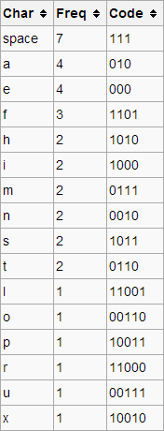
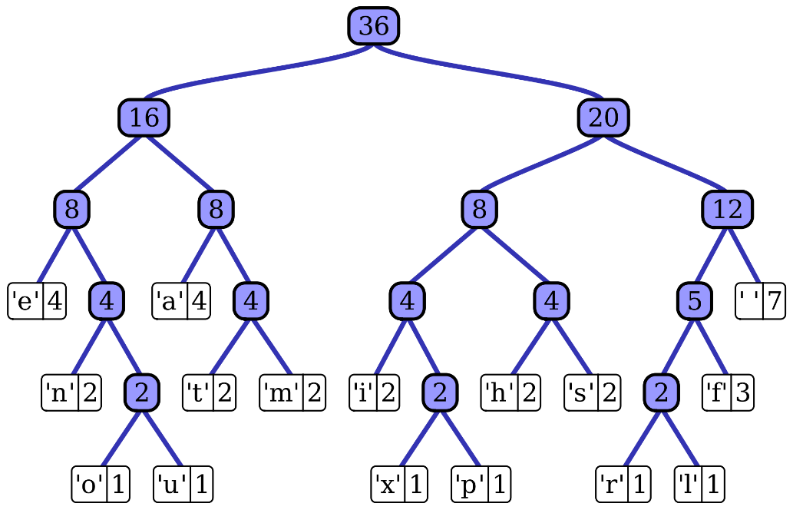
Huffman Encoding Example
In this example we are using Huffman Encoding to encode:
“this is an example of a huffman tree”
The binary tree for the encoding is drawn on the right.
As we can see there are 36 characters which is why the root node is 36.
Each character in the tree is represented by the number of times it occurs in the above statement.
The code for the character represents how to get to the character in the Huffman tree.

Slide 4
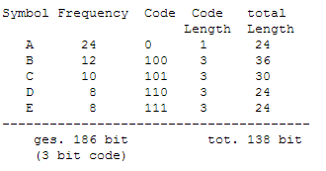
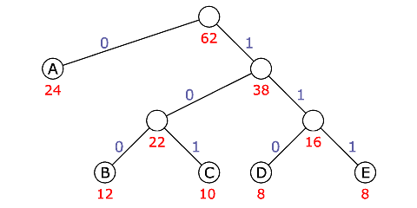
Huffman Encoding Example
In this example we have the symbols with their respective frequencies in the chart on the right along with their code.
The Huffman Encoding Tree is also shown on the bottom right.
We can see that the higher numbers get placed towards the top of the tree.

Slide 5
Huffman Encoding Hardware
Necessary Hardware for each Scan Chain:
Decoder
This decoder will decompress the vectors
Serializer
The serializer will be used to shift the bits into the Scan Chain
Will provide some parallelism between decoding and shifting
We want the serializer to shift the decoded bits into the scan chain at the same speed the decoder can decode the test vectors.

Slide 6
Huffman Encoding Hardware
In an actual implementation of Huffman Encoding the hardware needed isn’t very costly in terms of gates.
The number of gates in the decoder would depend on the number of inputs in circuit (the bigger the circuit the more costly the decoder).
The Serializer would just be a bunch of registers
The number of registers would also be based on the number of inputs in the circuit.
In our implementation we use code to do the encoding and decoding instead of using hardware.

Slide 7
Our Huffman Encoding
Explain our implementation Here

Slide 8
Our Huffman Encoding ATPG Flow
Show how our Huffman Encoding works with ATPG

Slide 9
Our Results
Show and Explain our results here

Slide 10
Conclusion
Give our conclusion

